Slide 1
Functions of Several Variables
Quadric Surfaces
Level Curves and Level Surfaces
Partial Derivatives

Slide 2
QUADRIC SURFACES
The equation
is called a second-degree equation in x, y, and z.
The graph of such equations are called quadric
surfaces or sometimes quadrics.

Slide 3
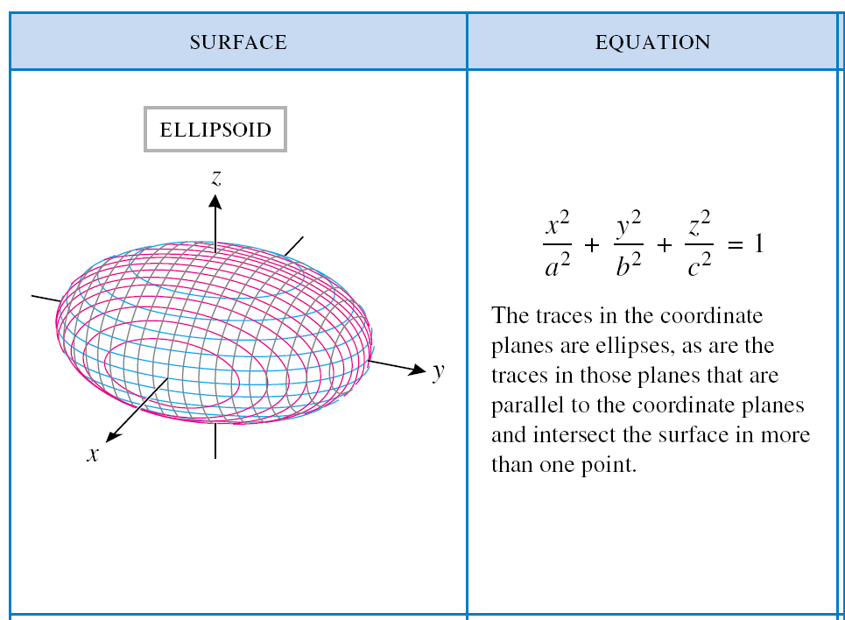
Table 11.7.1a (p. 823)

Slide 4
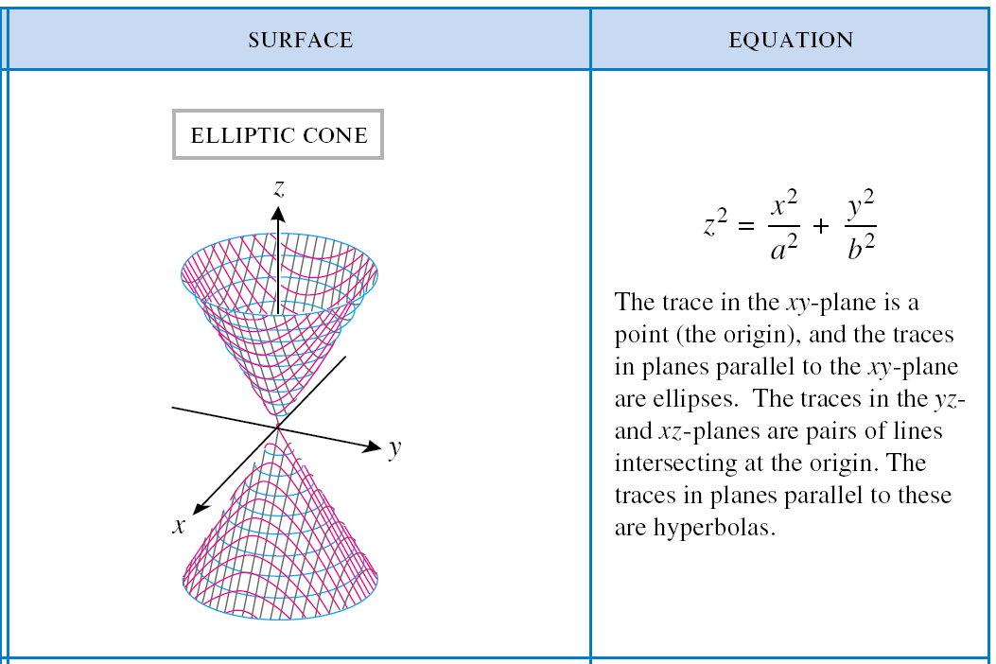
Table 11.7.1b (p. 823)

Slide 5
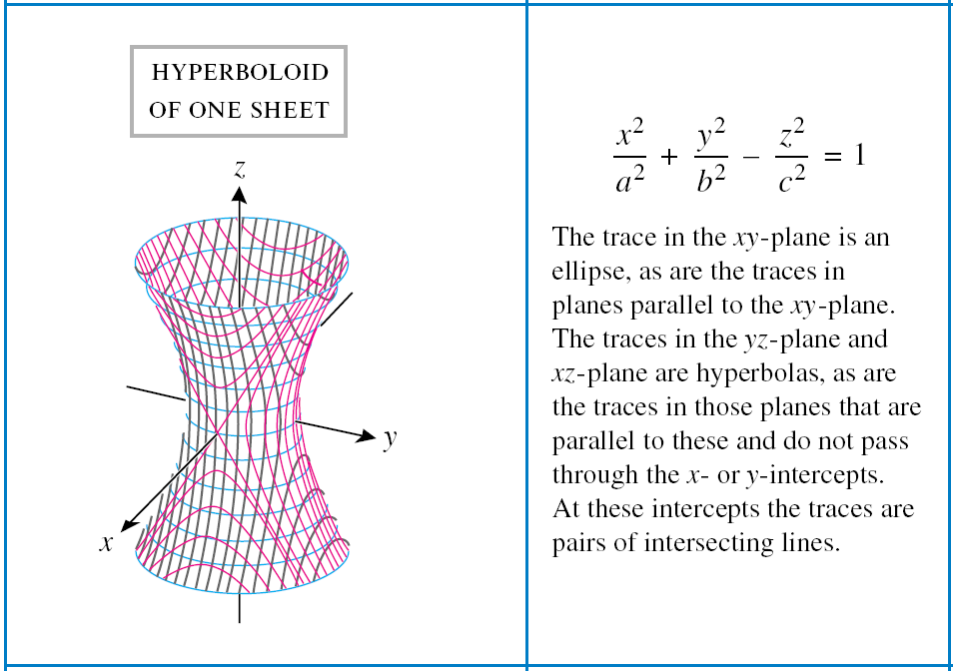
Table 11.7.1c (p. 823)

Slide 6
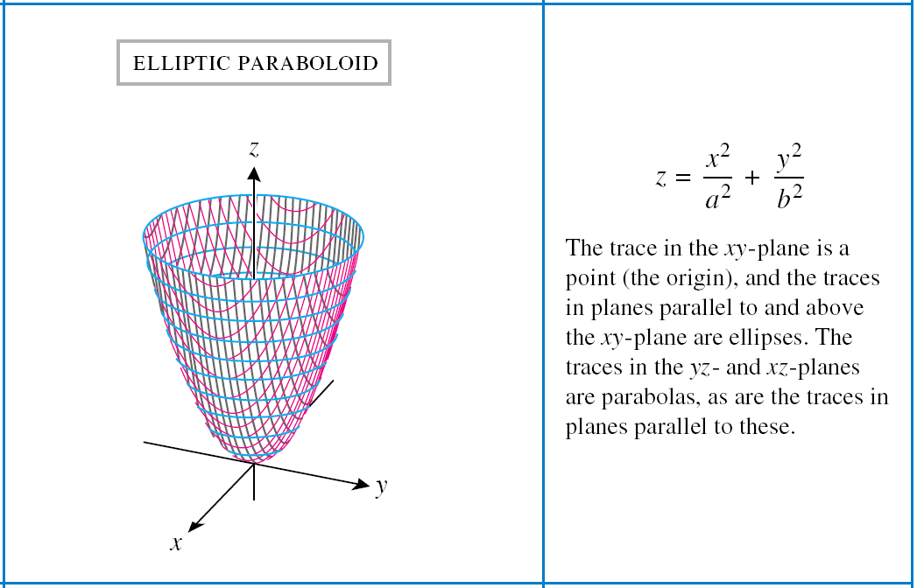
Table 11.7.1d (p. 823)

Slide 7
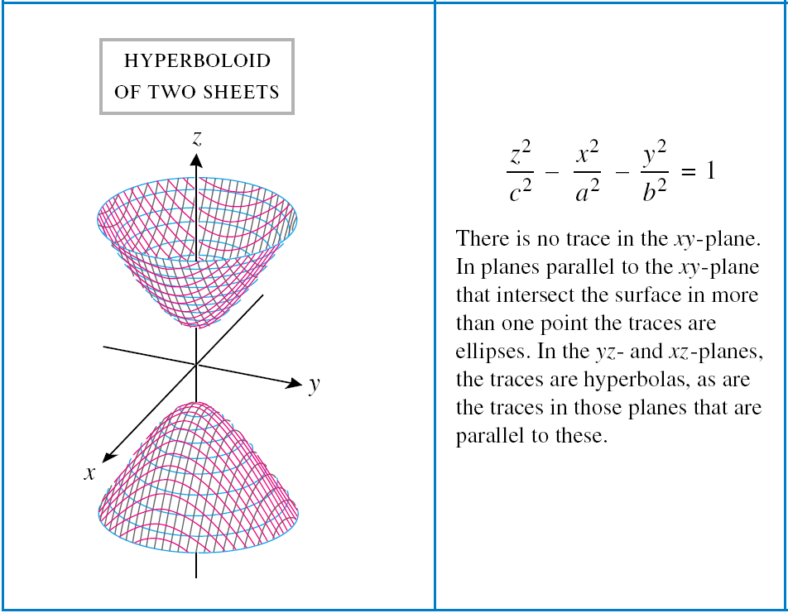
Table 11.7.1e (p. 823)

Slide 8
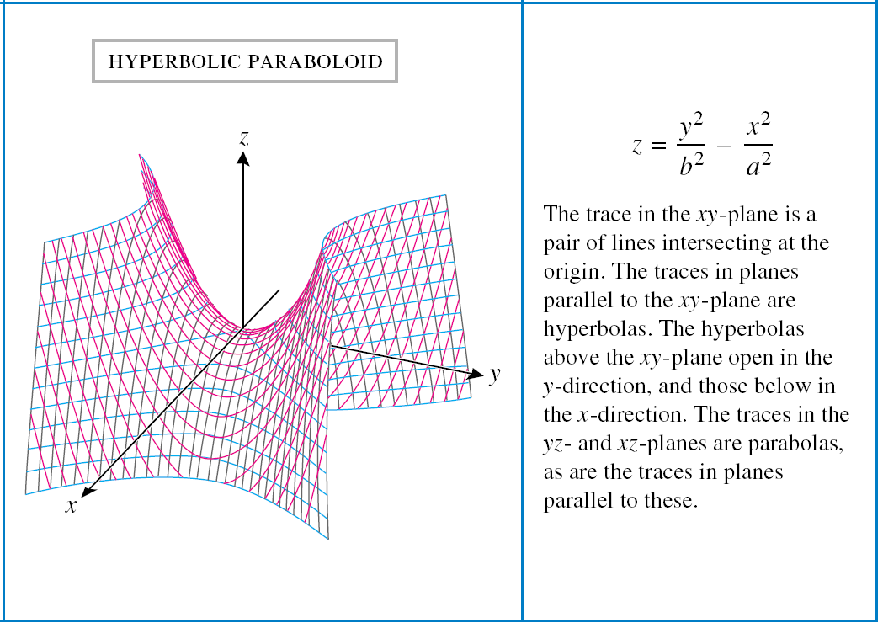
Table 11.7.1f (p. 823)

Slide 9

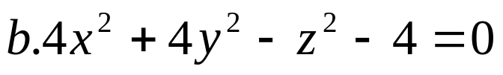
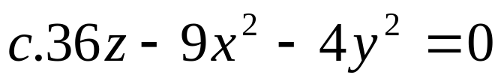

Techniques for Graphing Quadric Surfaces
Examples: Graph/sketch the following quadrics:
HW # 2 pp. 830 #’s 15, 17, 19, 21, 25

Slide 10
Functions of Two or More Variables
Introduction
There are many familiar formulas in which a given variable depends on two or more other variables.
Examples: 1. A = ½ bh
2. V = l w h
The terminology and notation for function of two or more variables is similar to that for functions of one variable.

Slide 11
Functions of Two or More Variables
Notations:
z = f(x, y)
- means that z is a function of x and y in the sense that a unique value of the dependent variable z is determined by specifying values for the independent variable.
w = f(x, y, z)
- expresses w as a function of x, y, and z.

Slide 12
Functions of Two or More Variables
Definition 1. A function f of two variables, x and y, is a rule that assigns a unique real number f(x, y) to each point (x, y) in some set D in the xy-plane.
Definition 2. A function f of three variables, x, y, and z, is a rule that assigns a unique real number f(x, y, z) to each point (x, y, z) in some set D in three dimensional space.

Slide 13



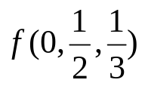
Evaluation of Functions and Natural Domain of the Function
Examples:
Let . Find and sketch or describe in words the natural domain of f.
Let . Find and sketch or describe in words the natural domain of f.

Slide 14
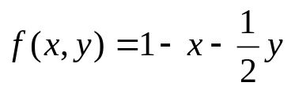

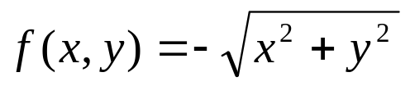
Graph of Functions of Two Variables
The graph of f(x, y) in xyz-space is the graph of the equation z = f(x, y). In general, such a graph will be a surface in 3-space.
Examples: Describe the graph of the function in an xyz-coordinate system.
a.
b.
c.

Slide 15
Level Curves
Level Curves

Slide 16
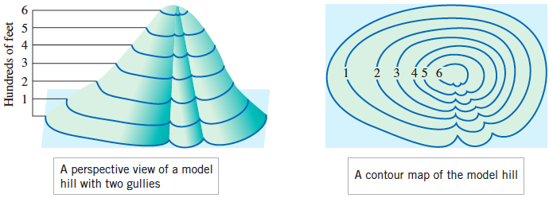
Figure 13.1.3 (p. 909)

Slide 17
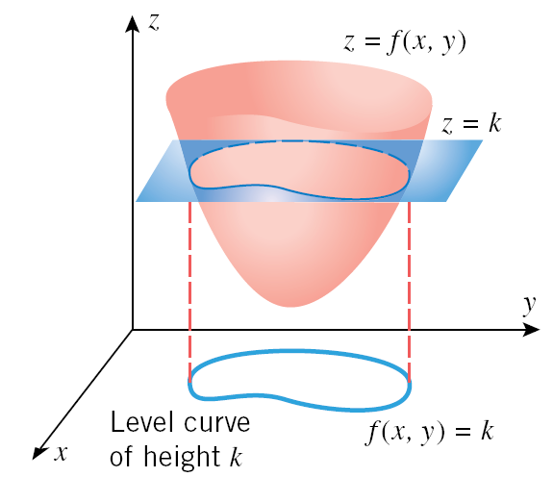
Figure 13.1.4 (p. 909)

Slide 18
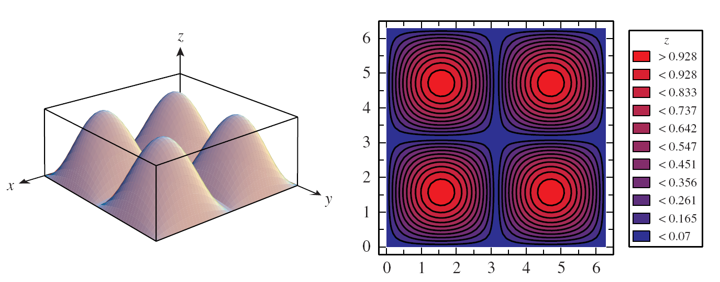
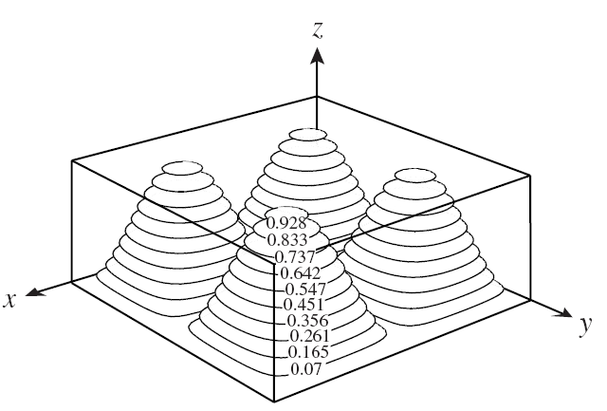
Figure 13.1.8 (p. 911)

Slide 19


Level Curves
Examples:
1. Sketch the contour plot of using level curves of height k = 0, 1, 2, 3, 4, 5.
Sketch the contour plot of using level curves of height k = -6, -4, -2, 0, 2, 4, 6.

Slide 20

Level Surfaces

Slide 21
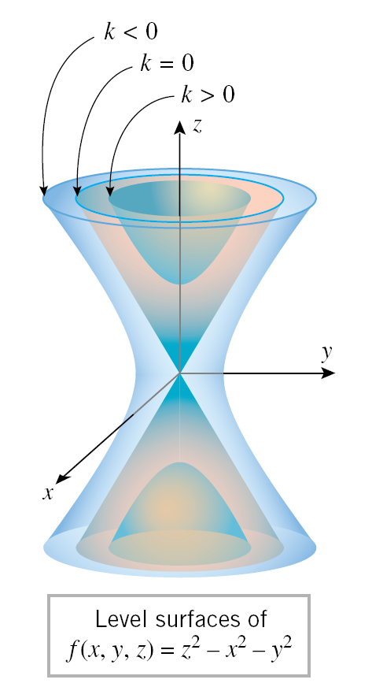
Figure 13.1.10 (p. 912)

Slide 22
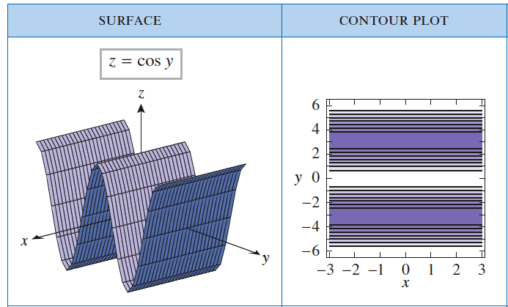
Table 13.1.2a (p. 913)

Slide 23
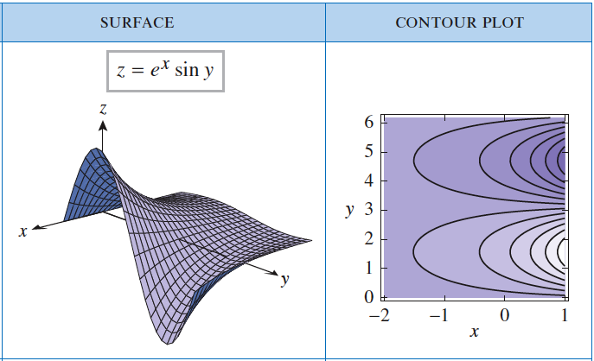
Table 13.1.2b (p. 913)

Slide 24
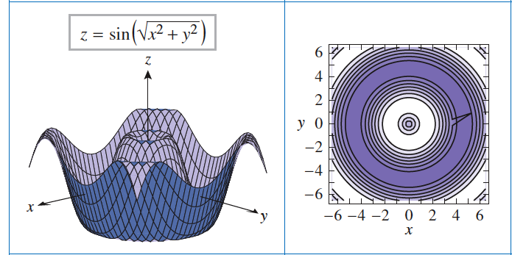
Table 13.1.2c (p. 913)

Slide 25
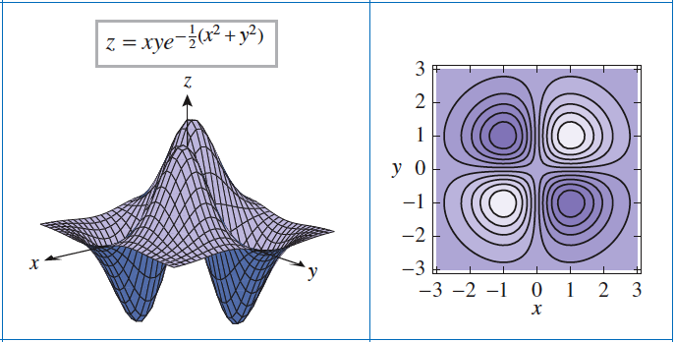
Table 13.1.2d (p. 913)

Slide 26
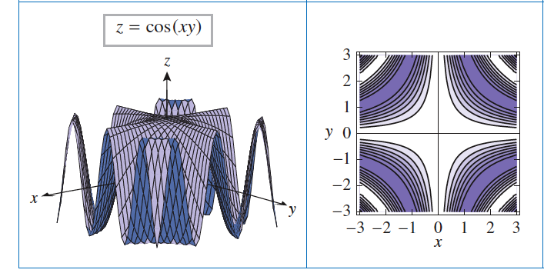
Table 13.1.2e (p. 913)

Slide 27
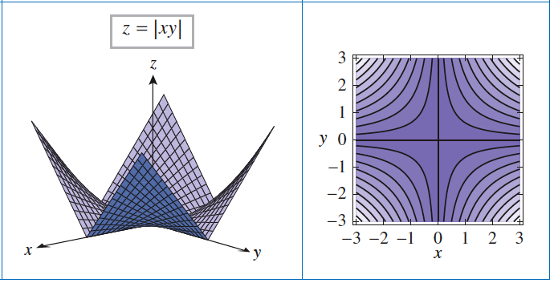
Table 13.1.2f (p. 913)

Slide 28


Examples:
Describe the level surfaces of the following
a.
b.

Slide 29
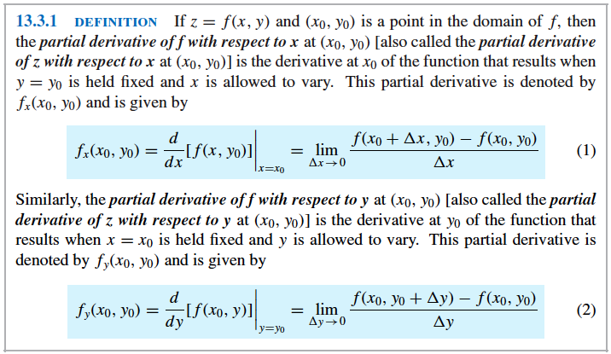
Partial Derivatives
A. Partial Derivatives of Functions with Two Variables

Slide 30



B. Partial Derivatives of Functions with more than Two Variables
For a function f(x, y, z) of three variables, there are three partial derivatives
The partial derivative is calculated by holding y and z constant and differentiating with respect to x. For the variables x and z are held constant, and for the variables x and y are held constant.

Slide 31











Other Partial Derivative Notations
1. z = f(x, y)
, , -
, , -
w = f(x, y, z)
, , -
, , -
, , -
Partial derivative of f with respect to x
Partial derivative of f with respect to y
Partial derivative of w with respect to x
Partial derivative of w with respect to y
Partial derivative of w with respect to z

Slide 32
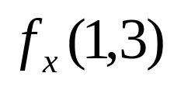

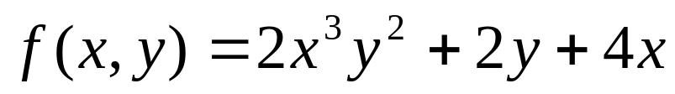


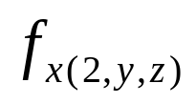
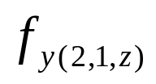


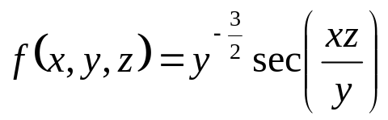
Find and for the function
.
Find and if
Let . Find , ,
Find , , and if

Slide 33

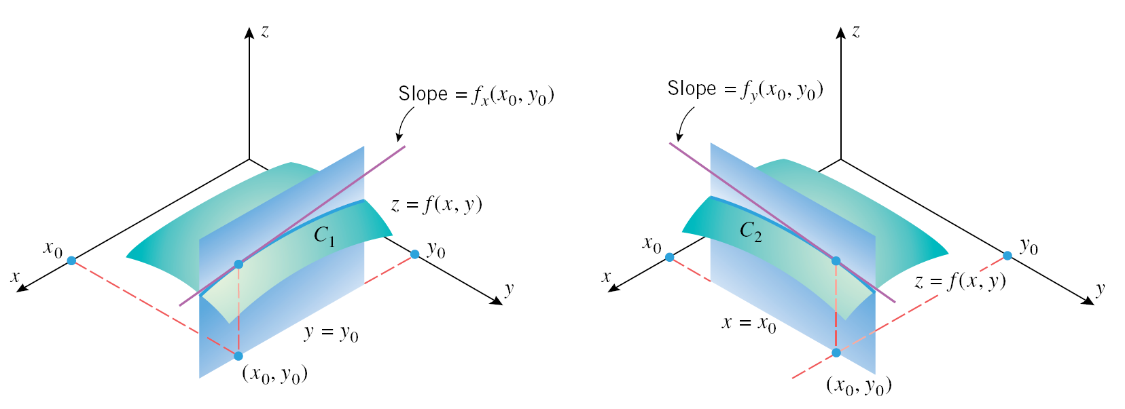
Partial Derivatives Viewed as a Rate of Change and Slopes
Suppose that C₁ is the intersection of the surface z = f(x, y) with the plane y = y₀ and that
C₂ is the intersection with the plane x = x₀. Thus (x, y₀) can be interpreted as the rate
of change of z with respect to x along the curve C₁ and (x₀,y) can be interpreted as the
rate of change of z with respect to y along the curve C₁.

Slide 34

Examples:
Let
Find the slope of the surface z = f(x, y) in the x-direction at the point (1, -2).
Find the slope of the surface z = f(x, y) in the y-direction at the point (1, -2).

Slide 35
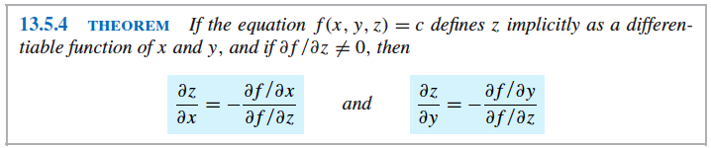
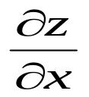
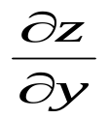

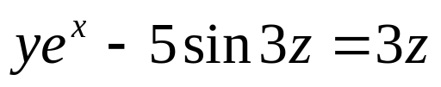
Examples: Find and by implicit differentiation
1.
2.
Implicit Partial Differentiation

Slide 36


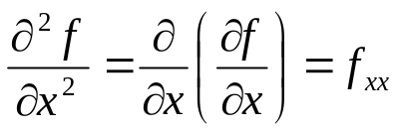
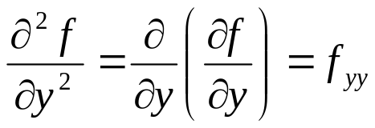
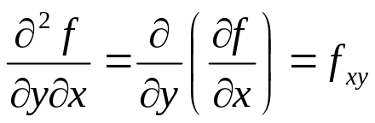
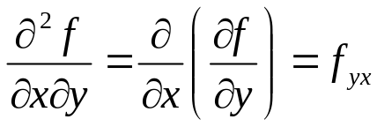
Higher Order Partial Derivatives
Suppose that f is a function of two variables x and y. Since the partial derivatives and are also function of x and y, these functions may themselves have partial derivatives. This gives to four possible second-order partial derivatives of f which are defined by
Note: The last two cases
are called the mixed second
order partial derivatives or
the mixed second partials.
Differentiate twice with respect to x
Differentiate twice with respect to y
Similar conventions apply to
the second-order partial
derivatives of a function of
three variables.
Differentiate twice with respect to x and then with respect to y
Differentiate twice with respect to y and then with respect to x

Slide 37




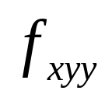
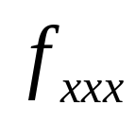
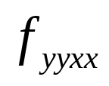
Higher Order Partial Derivatives
Note: Observe that the two notations for the mixed second partials
have opposite conventions for the order of differentiation. In the” “ notation,
the derivatives are taken right to left, and in the “subscript” notation, they
are taken left to right.
Examples:
1. Find the four possible second-order partial derivatives of z or f (x, y).
a.
b.
Given: Find:
(0, 1) b. (0, 1) c. (0, 1)

Slide 38
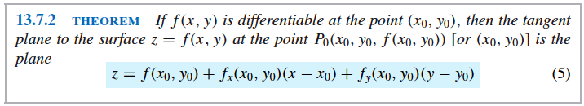
Application of Maxima and Minima of Functions of Two Variables
I. Equation of Tangent Plane and Normal Line

Slide 39
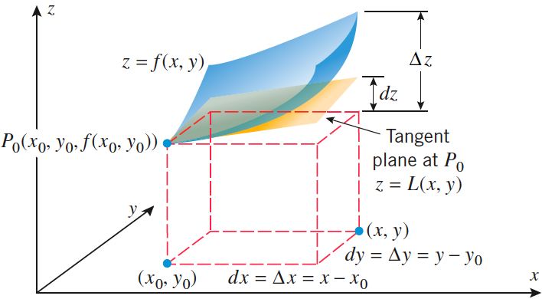
Figure 13.7.5 (p. 974)

Slide 40

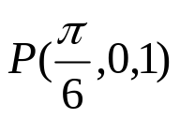
# 1/p.975
Consider the ellipsoid x² + y² + 4z² = 12.
Find an equation of the tangent plane to the ellipsoid at the point (2, 2, 1).
Find parametric equations of the line that is normal to the ellipsoid at (2, 2, 1).
2. # 5/p.975
Find an equation for the tangent plane and parametric equations for the normal line to the surface at the point

Slide 41
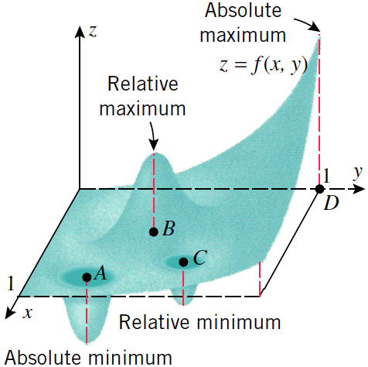
Maxima and Minima of Functions of Two Variables
If we imagine the graph of f of two variables to be
A mountain range, then the mountaintops, which
Are the highpoints in their immediate vicinity, are
Called relative maxima of f, and the valley bottoms,
Which are the low points in their immediate
Vicinity, are called relative minima of f.
Just a geologist might be interested in finding
The highest mountain and deepest valley in an
Entire mountain range, so you might be
Interested in finding the largest and smallest
Values of f(x, y) over the entire domain of f.
These are called the absolute maximum and
Absolute minimum values of f.

Slide 42
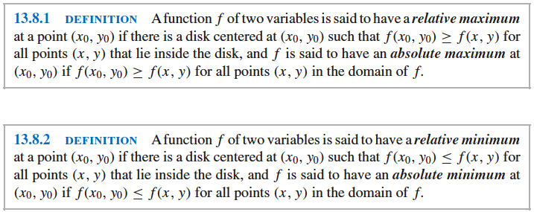
Figure 13.8.2 (p. 977)
Maxima and Minima of Functions of Two Variables

Slide 43
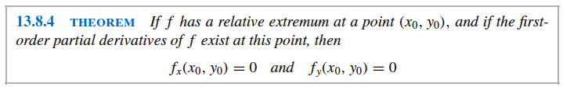
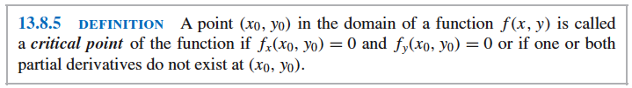
Finding Relative Extrema
Maxima and Minima of Functions of Two Variables

Slide 44
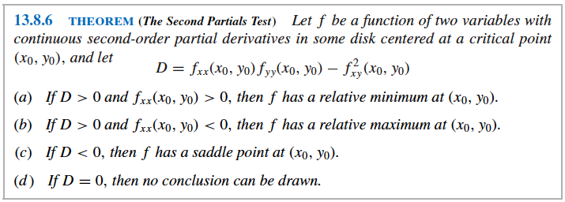

Maxima and Minima of Functions of Two Variables

Slide 45
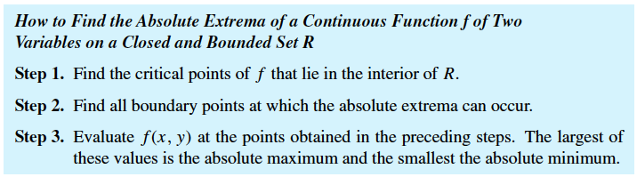
Maxima and Minima of Functions of Two Variables

Slide 46


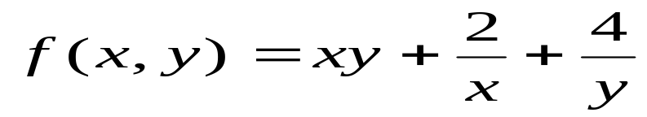
Maxima and Minima of Functions of Two Variables
Examples: Locate all relative maxima, relative minima and saddle points, if any.
1.
2.
3.

Slide 47

Application of Maxima and Minima of Functions of Two Variables
Example #6/p.983
Determine the dimensions of a rectangular box, open at the
top, having a volume of 32 ft³, and requiring the least
amount of material for its construction.
#37/p. 987
Find three positive numbers whose sum is 48 and such that
their product is as large as possible.
#39/p.987
Find all points on the portion of the plane x + y + z = 5 in the
first octant at which has a maximum value.

